Slide 1

Housing Price Analysis
Tianyue yang
nick ayvazian
James Richards
Alex Gainer

Slide 2
Data Sources
Zillow CSV:
https://www.zillow.com/research/data/
Zillow Home Value Index – “A smoothed, seasonally adjusted measure of the typical home value and market changes across a given region and housing type (at zipcode level).”
Data ranges from 1996 to 2021

Slide 3
Data Sources
Census CSV:
From class activity 06-Python-APIs\3\Activities\08-Ins_Census\Solved\CensusData.csv
2020 Census data by zipcode

Slide 4
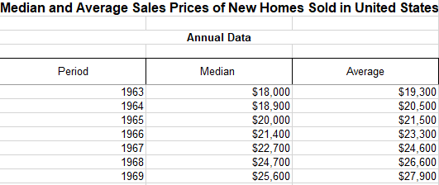
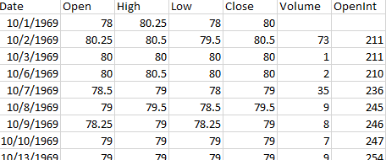
Data Sources
Median and Average Sale Price of Houses Sold (1963 – Present) – Census.gov
Historical S&P500 and Lumber Futures Prices - https://stooq.com/

Slide 5
Data Cleaning
Split Zillow into metro & suburban datasets
Clean and Merge Historical Data by Date (Monthly)

Slide 6
Home Value vs Poverty Rate

Slide 7
Home Value vs Median Age

Slide 8
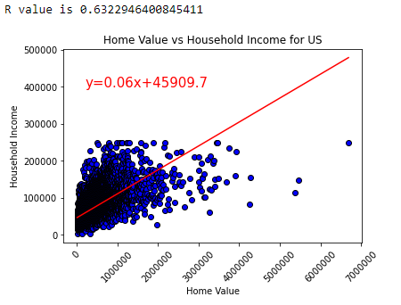
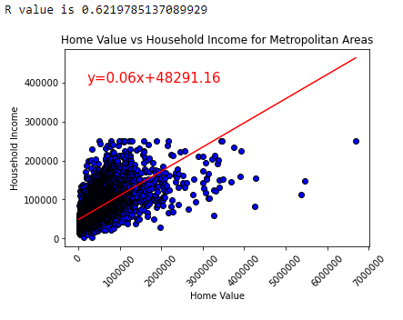
Home Value vs Income
As household income increase, home values also increase

Slide 9
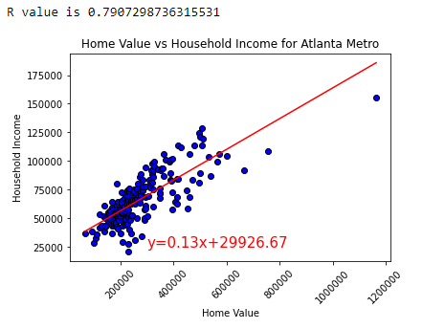
Home Value vs Income
As household income increase, home values also increase
Positive correlation for metro Atlanta area with stronger correlation coefficient

Slide 10
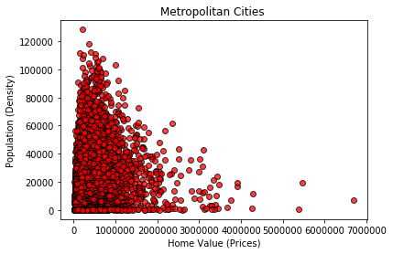
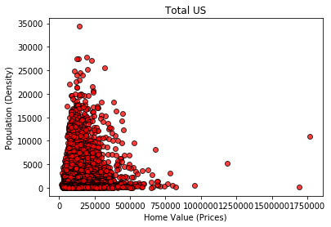
Home Value vs Population Density
Metro population density shows that the higher
the population, the higher the housing prices.
Suburban population density shows that the
lower the population, the lower the housing prices.

Slide 11
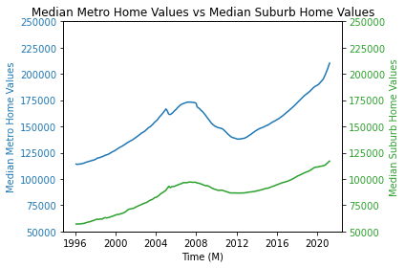
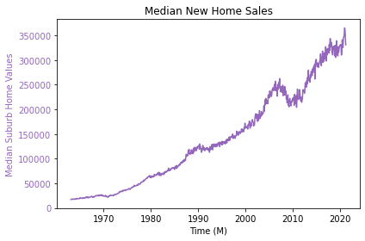
Historical Home Value Trends

Slide 12
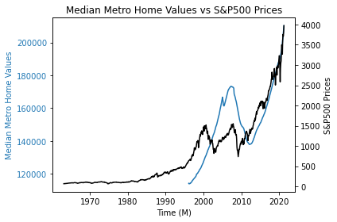
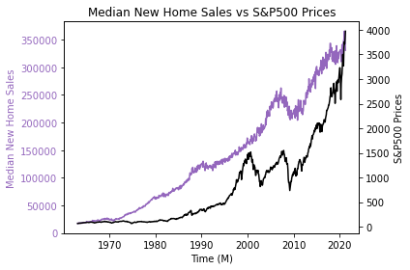
Historical Home Value Trends

Slide 13
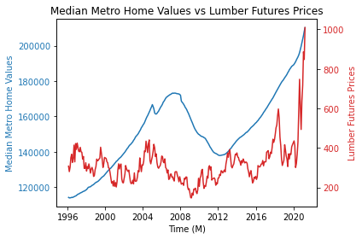
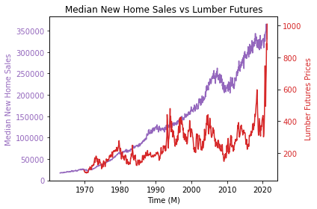
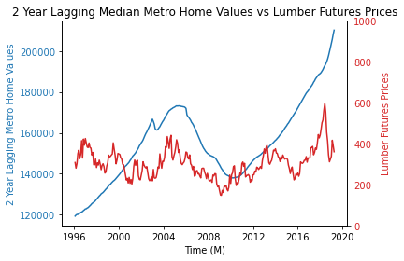
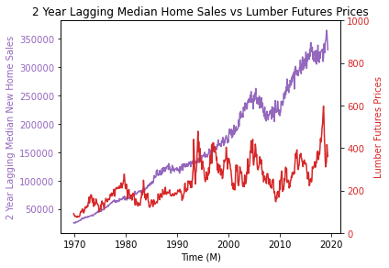

Slide 14
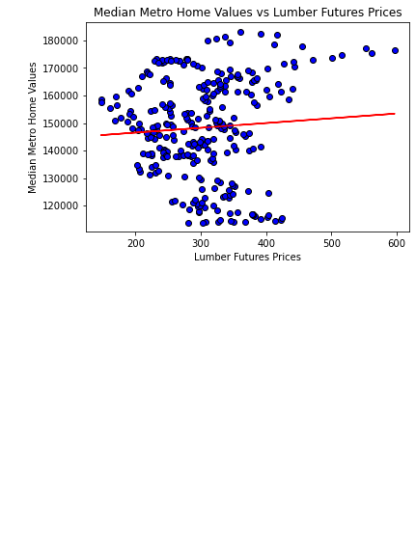
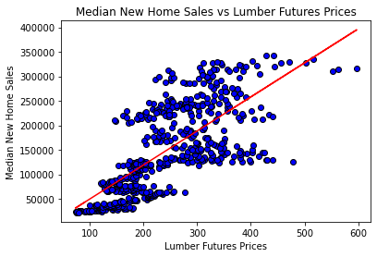
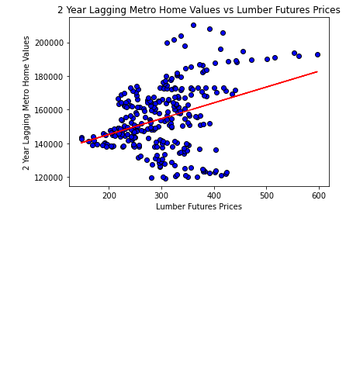
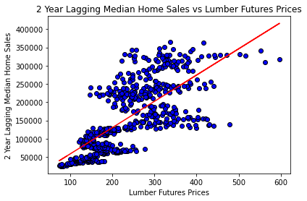
y = 17.33x + 143049.64
R2 = 0.004
y = 694.59x + -19844.35
R2 = 0.52
y = 93.84x + 126529.35
R2 = 0.12
y = 718.6x + -13209.07
R2 = 0.51

